Slide 1
Digital twin for wind energy industry
Adrien Hirvoas, Ph.D. - FEM
ISEN Yncréa Ouest

Slide 2
Digital twin for wind energy industry
Day 1: Welcome and Introduction Why wind energy ? Digital Twin Overview Practical work - Python: TP – Python introduction TP – Pandas introduction TP – Anomaly detection | Day 2: Introduction Anomaly detection Practical work: TP – Anomaly detection Conclusion & Question

Slide 3
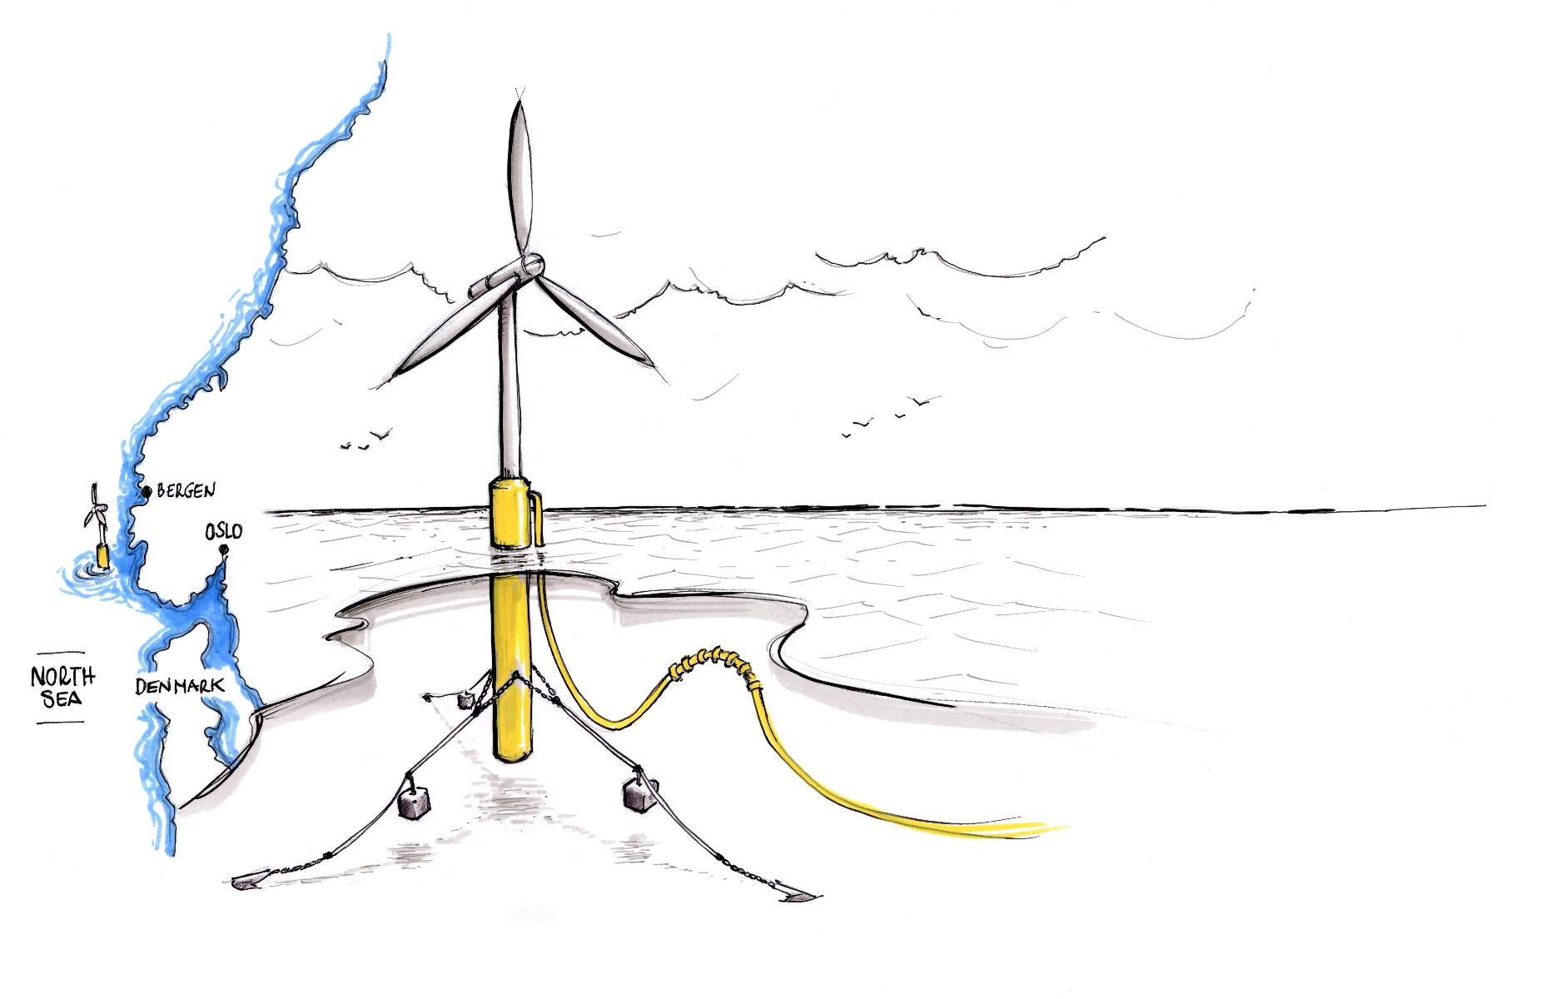
Day 1 - Agenda
Welcome and Introductions
Wind Turbine Modeling Overview
Overview of OpenFAST
OpenFAST modules
Practice – Onshore wind turbine

Slide 4





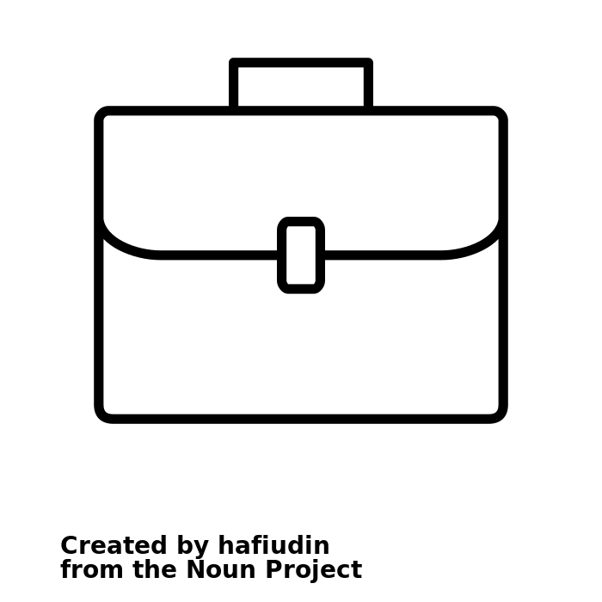
Welcome and Introductions
Myself in short
Personal Profile
Education
Research engineer with a focus on mathematics applied to floating offshore wind turbine
Engineering Diploma in Mechanical Engineering
Master of Research
Ph.D. in applied Mathematics
Contact info
Work Experience
Adrien Hirvoas
LinkedIn: adrien-hirvoas
Email: adrien.hirvoas@france-energie-marines.org
7 years of R&D in wind turbine system
Research institutes: IFPEN / FEM

Slide 5
Welcome and Introductions
French National Research Institute fully dedicated to Offshore Renewable Energies
Staff 85
Since 2012
€8M budget in 2021 100% allocated to R&D
Headquarters in Brest Offices in Le Havre, Nantes and Marseille
Institute supported by France 2030 investment plan
France Energies Marines (FEM) in short

Slide 6
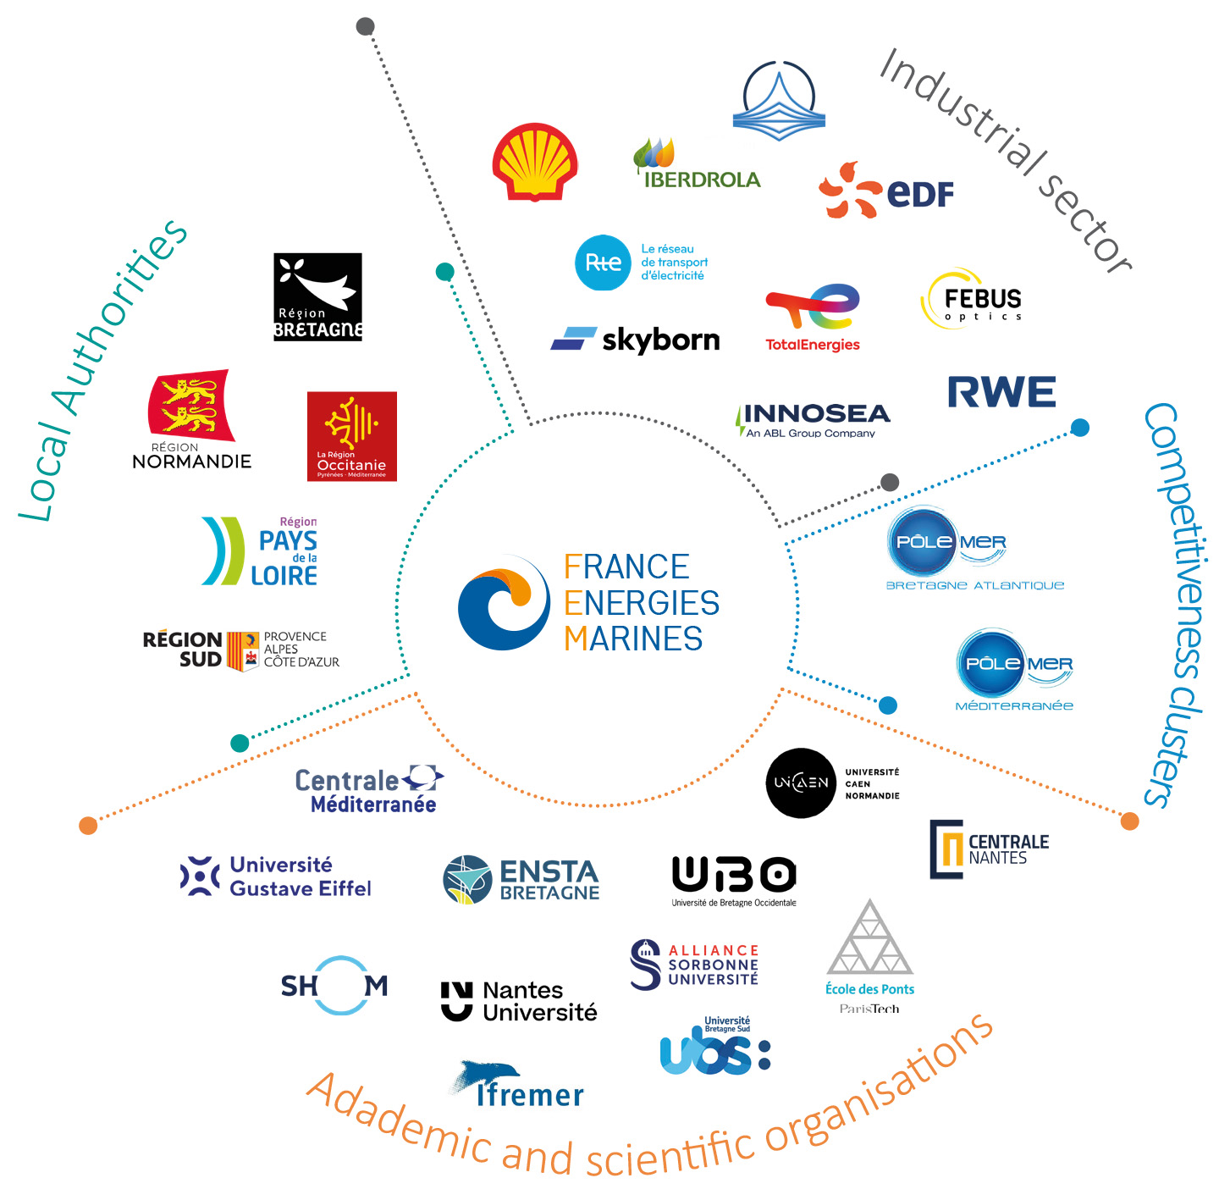
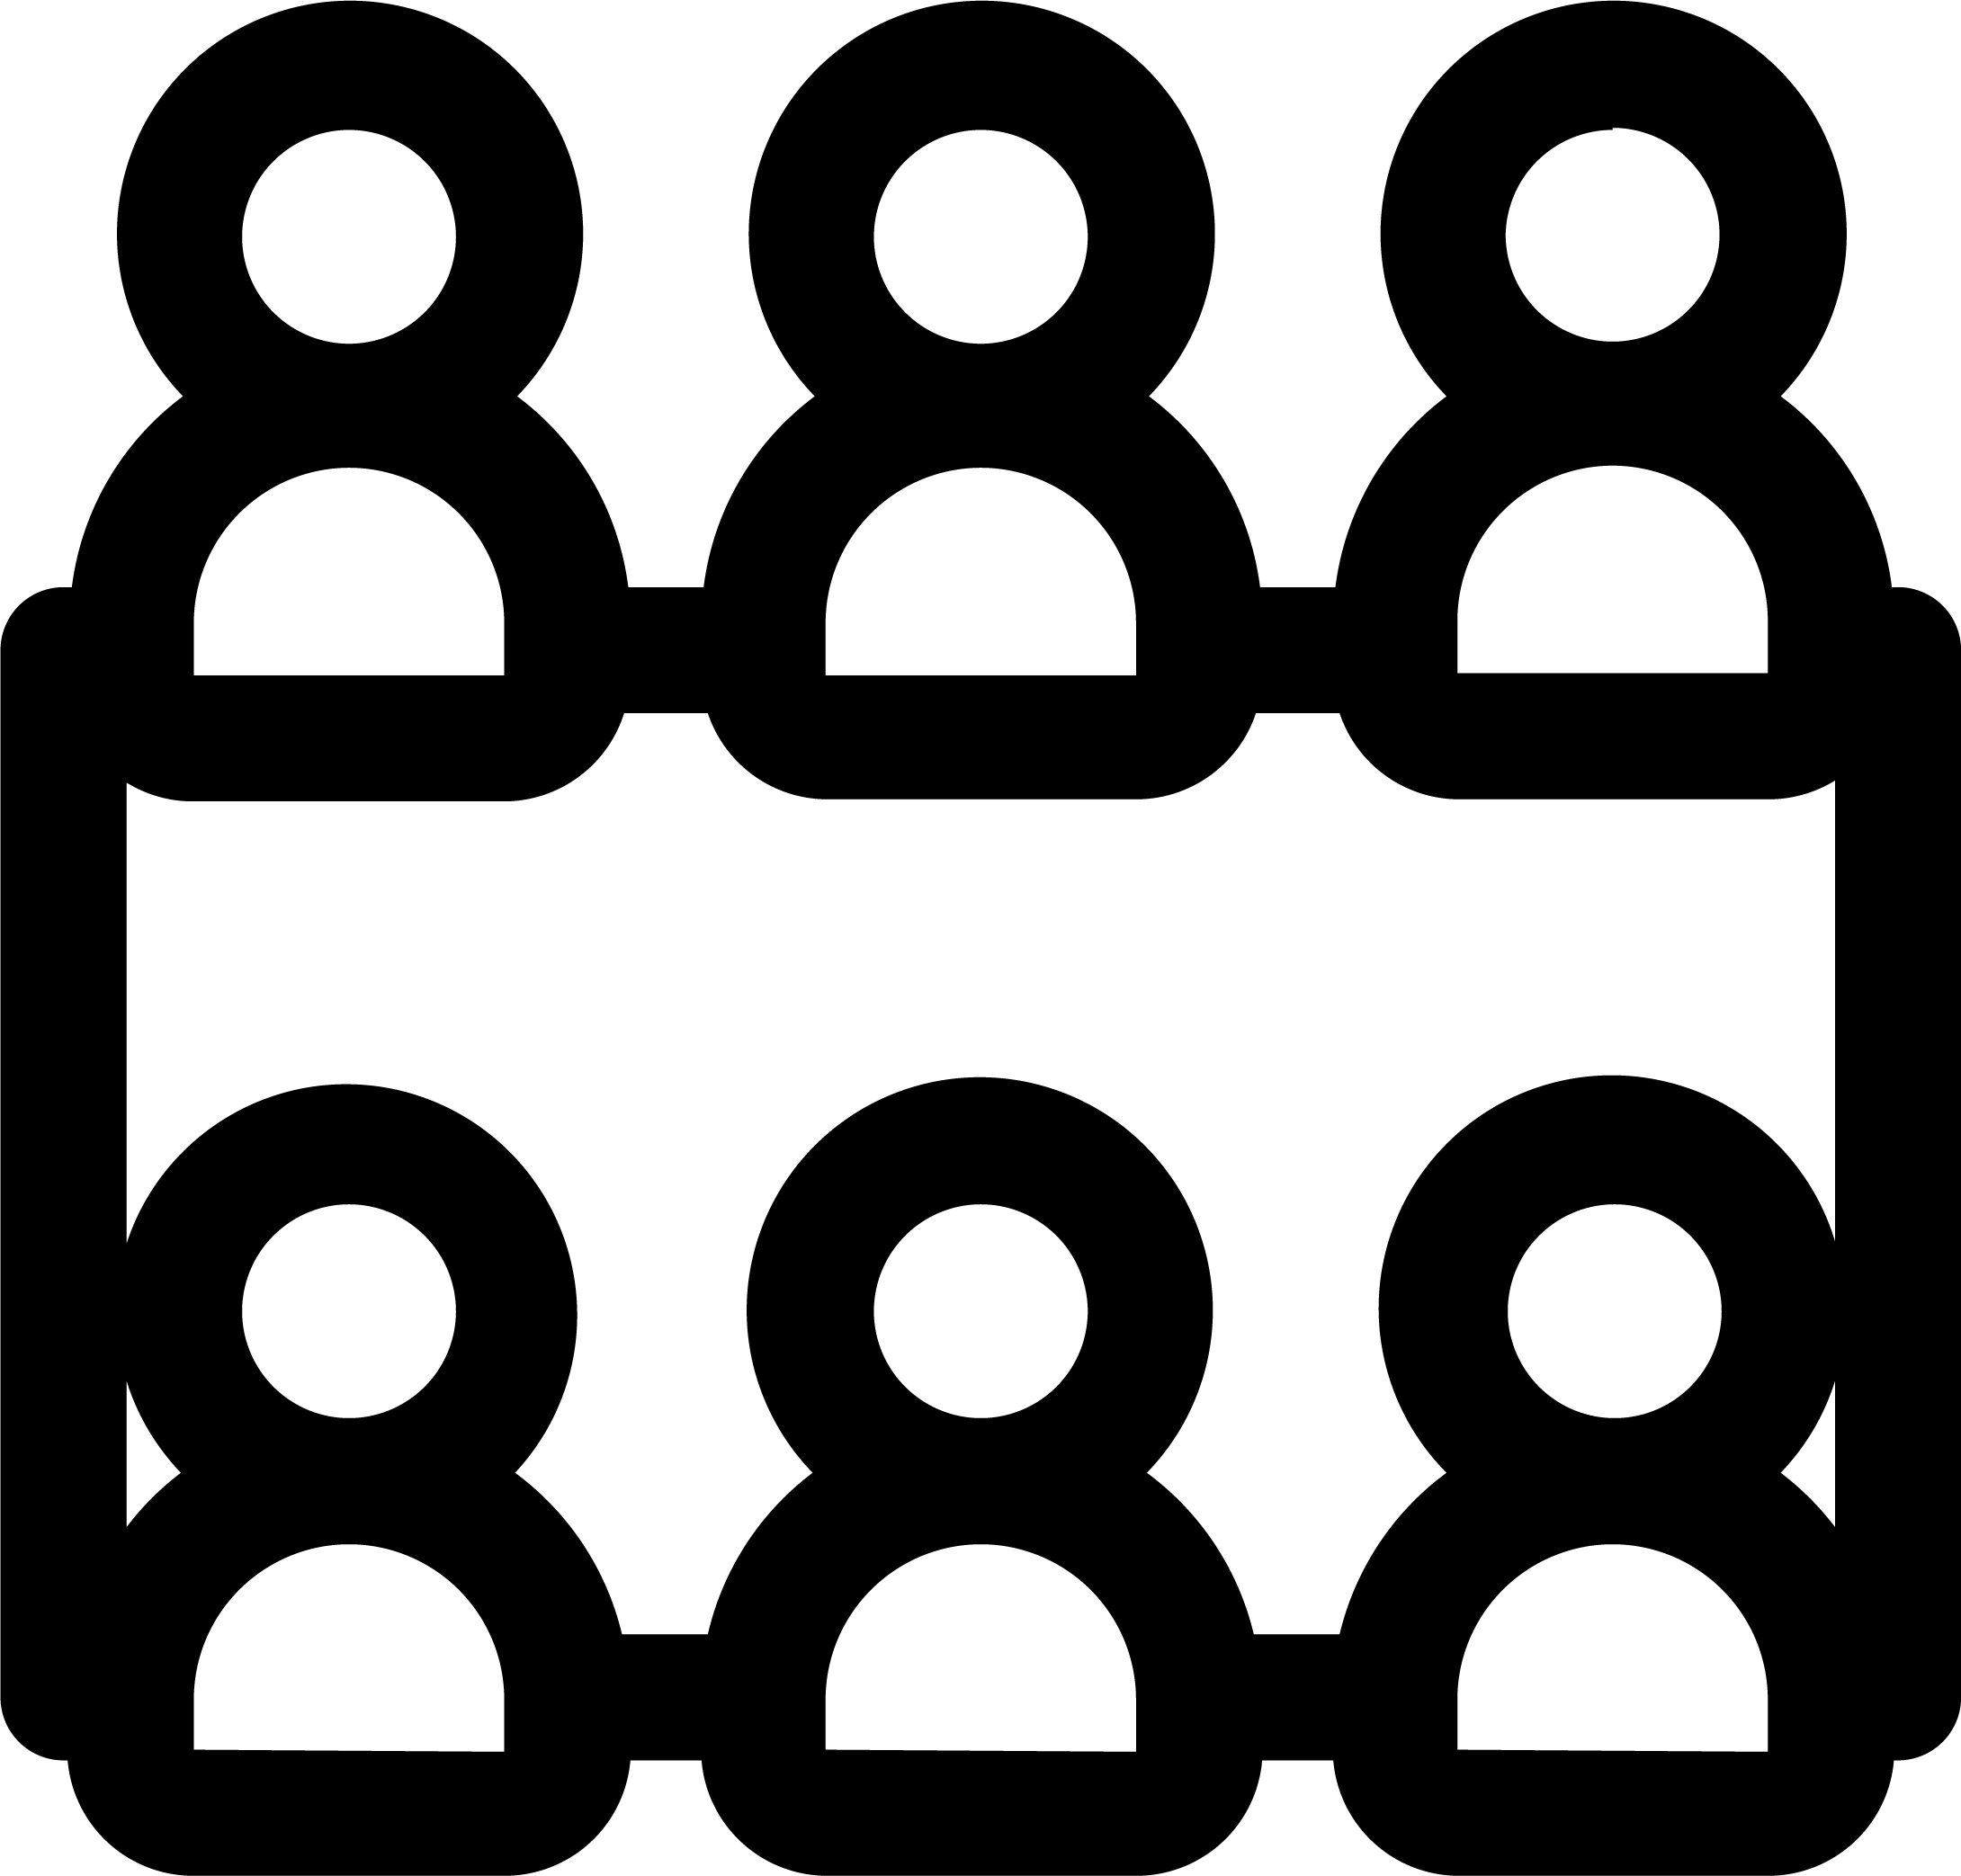
Welcome and Introductions
A public-private partnership
Ownership
50% public
50% private

Slide 7




Welcome and Introductions
FEM - Scientific and technological roadmap
SITE CHARACTERISATION
Spatialisation of observations
Characterisation of sea states
Wind characterisation at sea
Climate change
Hydrosedimentary processes
SYSTEMS DESIGN AND MONITORING
Structure, mooring and electrical cable
Hydrodynamic and structural coupling
Digital twins and in-service monitoring
Technological innovation
4 cross-cutting and complementary R&D programmes
ENVIRONMENTAL INTEGRATION
Effects on ecosystem compartments
Changing scale in terms of socio-ecosystem, space and time
Tools for environmental integration
FARM OPTIMISATION
Farm architecture
Grid integration (hydrogen...)
Installation, operation and maintenance

Slide 8
Welcome and Introductions
What about you ?

Slide 9
Welcome and Introductions
About this workshop
A GitHub repository is provided with some simulation folder and slides
2 x 3 hours
Don’t hesitate to ask questions (even during the presentation)
Objectives
Clarify the concept of Digital Twin
Allow you to build your first wind turbine numerical model

Slide 10
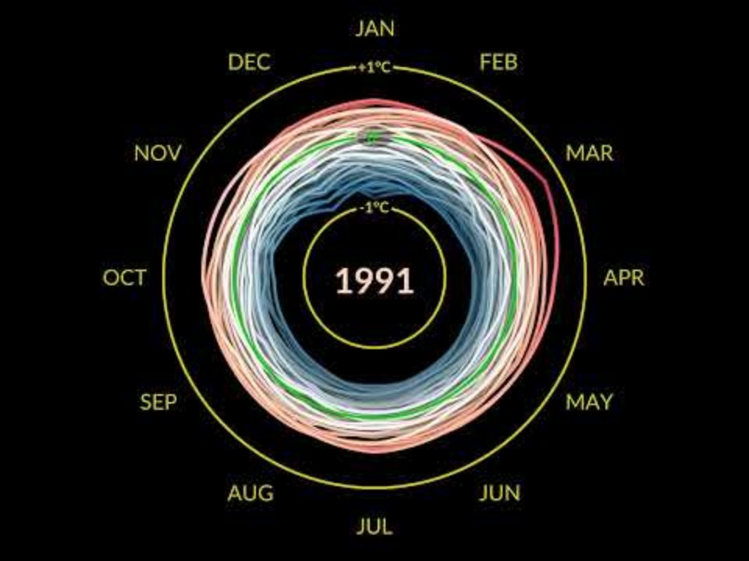
Why wind energy?
Evolution of the Earth’s temperature

Slide 11
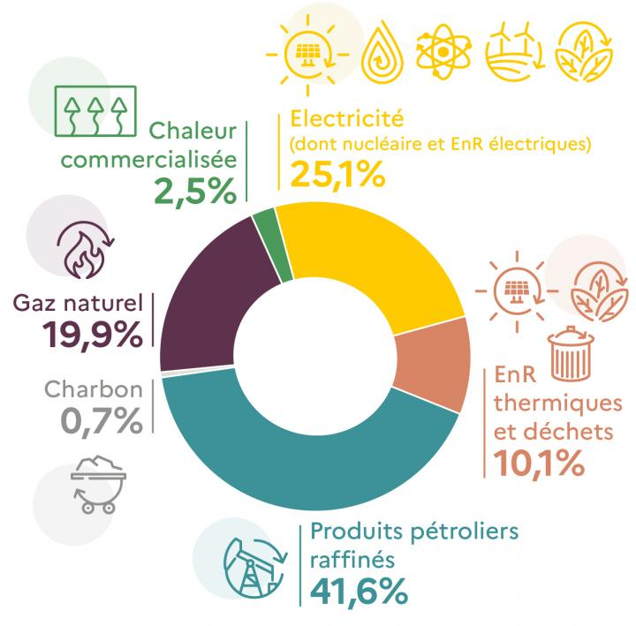
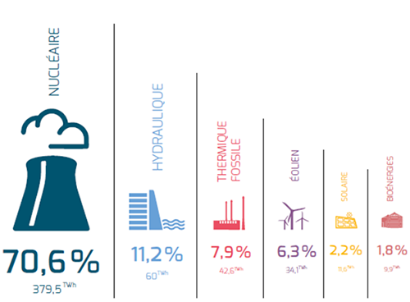
Why wind energy ?
French energy mix and electricity production

Slide 12
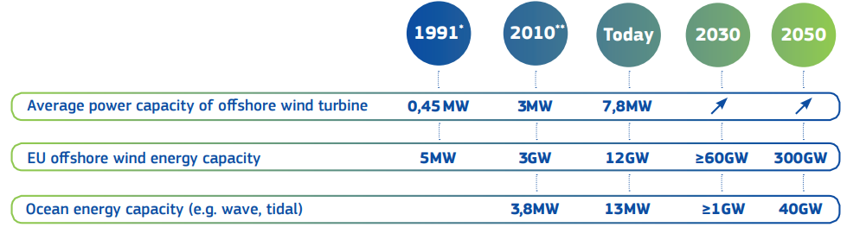
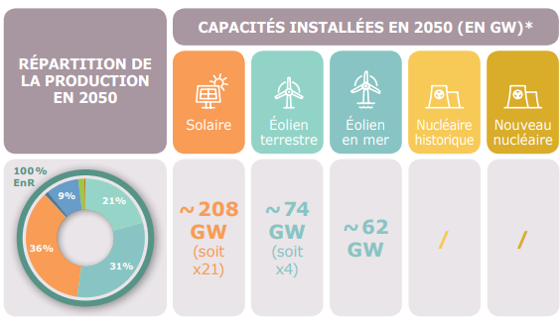
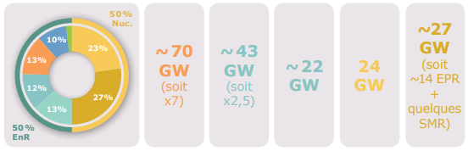
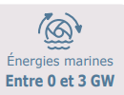
Why wind energy ?
For an emerging market with rich prospects
… at the European level
… and french
Source: Offshore Renewable Energy Strategy, European Commission, nov. 2020
RTE futures énergétiques 2050 (2021)
HYPOTHESE COMMUNE
Scenario M0
100% EnR en 2050
Scenario N03
EnR + nouveau nucléaire

Slide 13
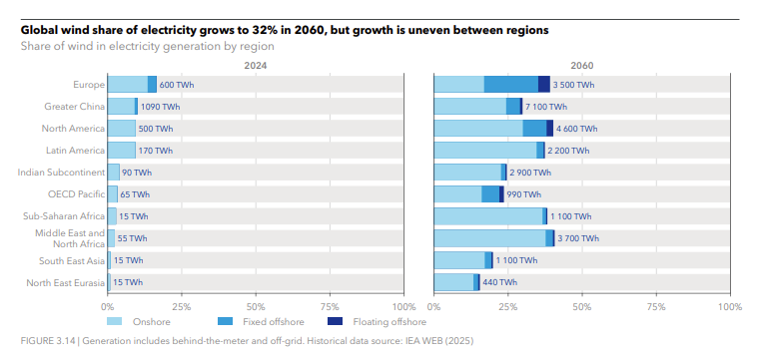
Why wind energy ?
Source : Energy Transition Outlook 2025, DNV.

Slide 14
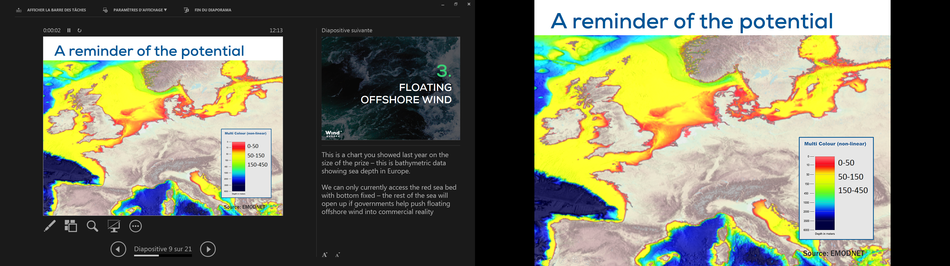
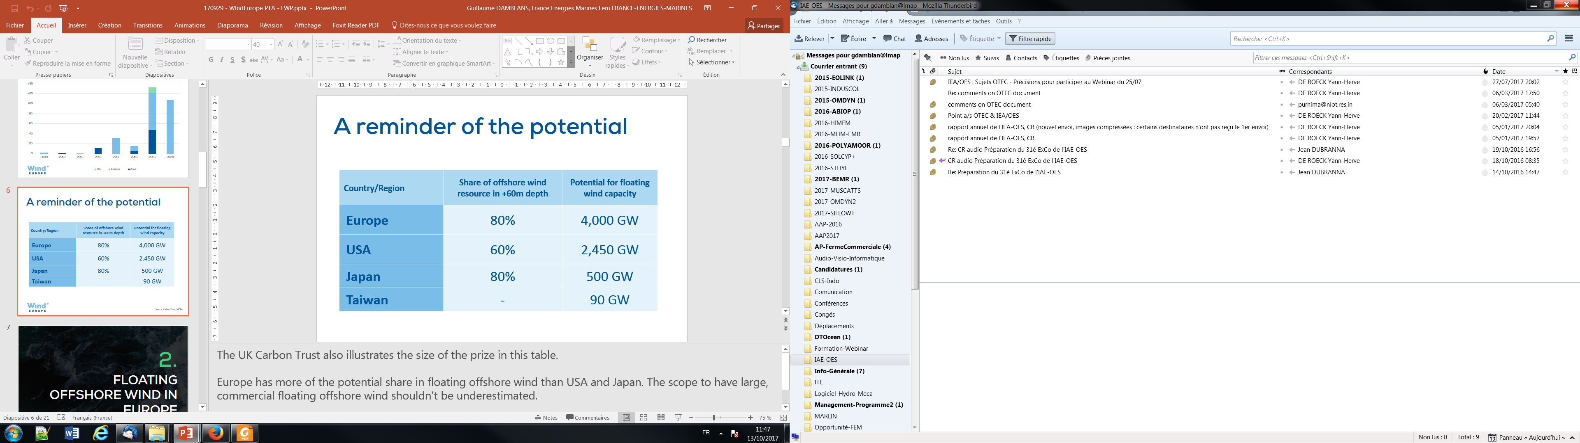
Why wind energy ?
Source: Carbon Trust

Slide 15
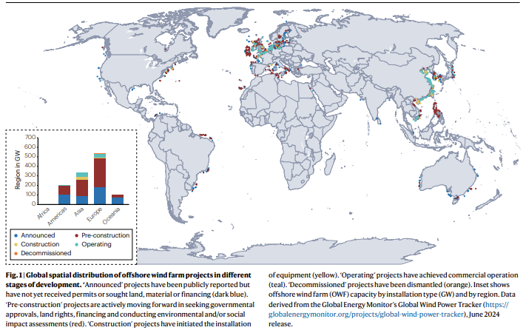
Why wind energy ?
Watson et al., 2025

Slide 16
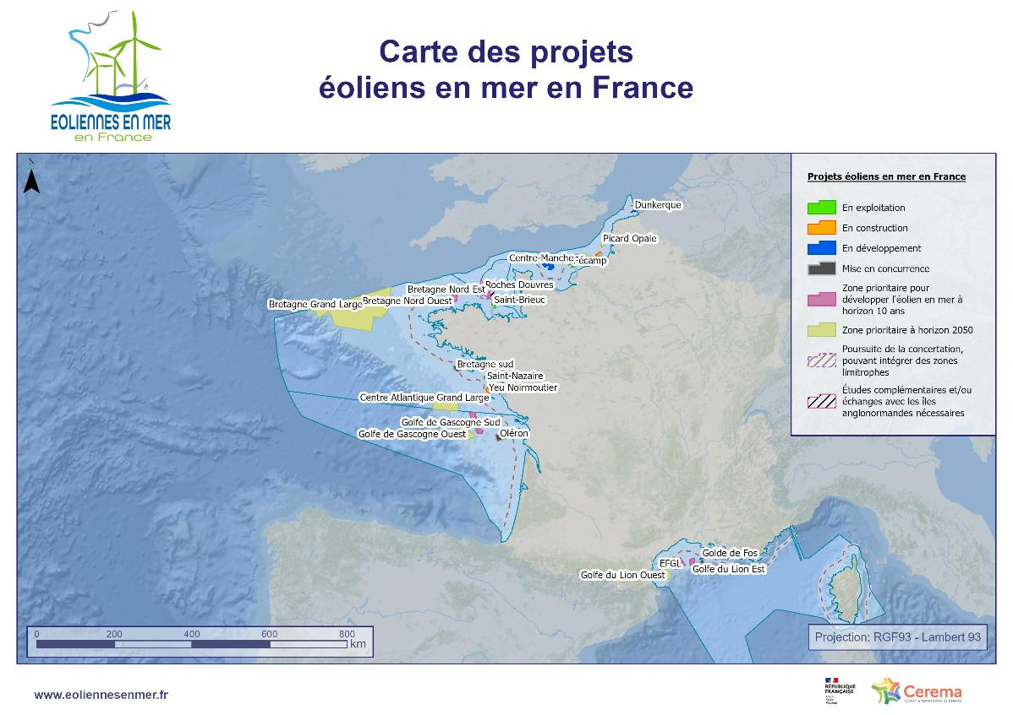

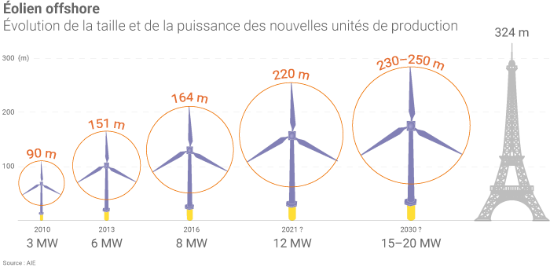
Objectives
Offshore windfarms in France
2023
2028
2035
2050
2.4 GW
5 GW
18 GW
45 GW
(UE: 300 GW)
Scale change in production units

Slide 17
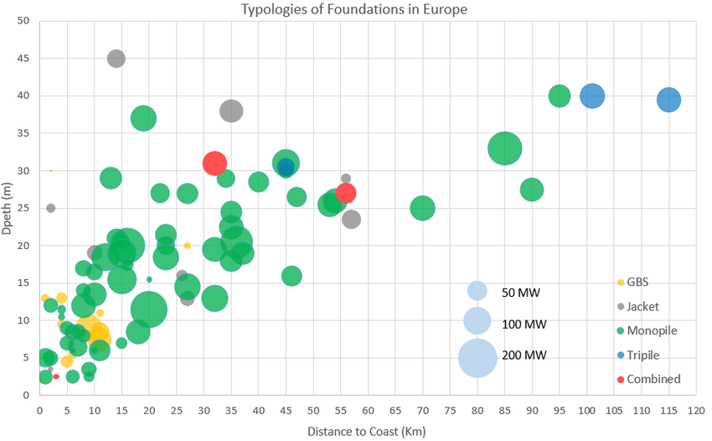
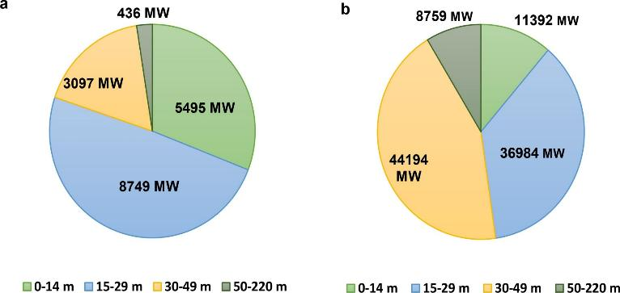
Where are the offshore windfarms?
The current limit for fixed OWF is around 60m depth. However, parks are being considered for depths of up to 80m and disruptive technologies could open the door to depths >100m.
Most of the current market is located on shallow continental shelves (Northern Europe, East Coast of the USA) floating opens the door to new markets (West Coast of the USA, Japan, Taiwan, Korea, Atlantic and Mediterranean coasts of Europe...)
a) Water depths for installed offshore wind farms (in 2019), b) Water depths for future offshore wind farms.

Slide 18
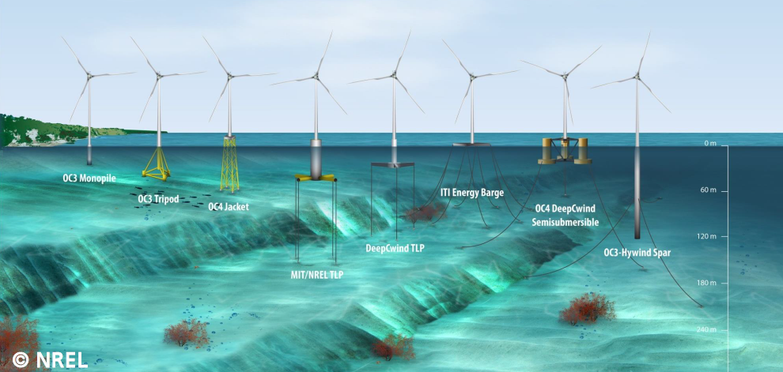
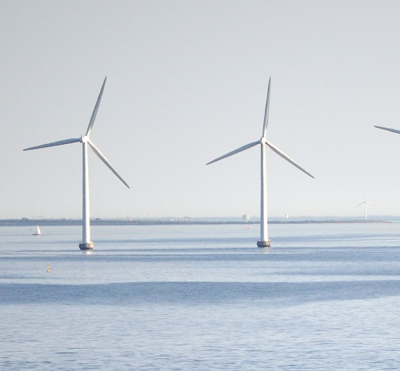
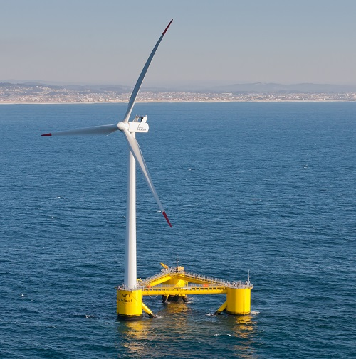
Why wind energy ?
Offshore wind turbines (still in development)
Fixed wind turbines
Floating wind turbines

Slide 19
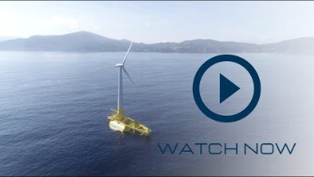
Why wind energy ? – DemoSATH

Slide 20
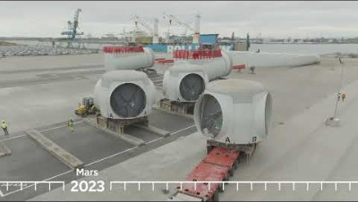
Why wind energy ? – Provence Grand Large

Slide 21
Digital Twin Overview - Operation & Maintenance

Slide 22
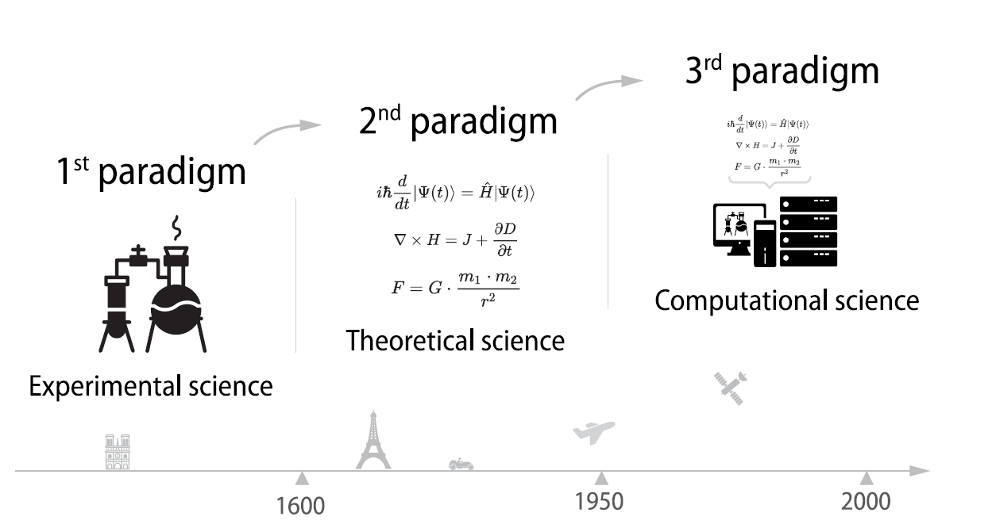
Digital Twin Overview – Scientific paradigm

Slide 23
Digital Twin Overview – Numerical modelling
Why?
Lower wind cost of energy requires technology advancement through improved engineering capability founded on physics.
What?
Improved physics-based engineering design competence and software needed to advance wind energy technology.
How?
Use the knowledge, data, and results from broader wind research to improve physics-based engineering design competence and software.
Physic-Based
Knowledge
Real-World
Data
Engineering Design Competence and Models
Advanced Wind
Energy
Technology at
Lower Cost

Slide 24
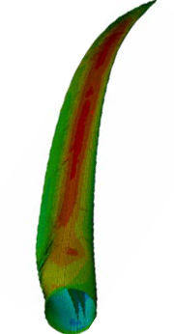
Digital Twin Overview – Numerical Modelling
Coupling Between Fluids, Structures, and Controls
Controls
Aerodynamics
Hydrodynamics
Structures

Slide 25

Digital Twin Overview – What do you think
What is a Digital Twin ? (For you)
An online survey: https://forms.gle/QMrxHDSeP187mjAS8
Possible responses:
A fully defined model, able to simulate the full behavior of an asset
A model similar to a real system that receives data from sensors on the real asset
A 3D model
Simulation of a manufacturing asset
A moving model
All of the above
I don’t know

Slide 26
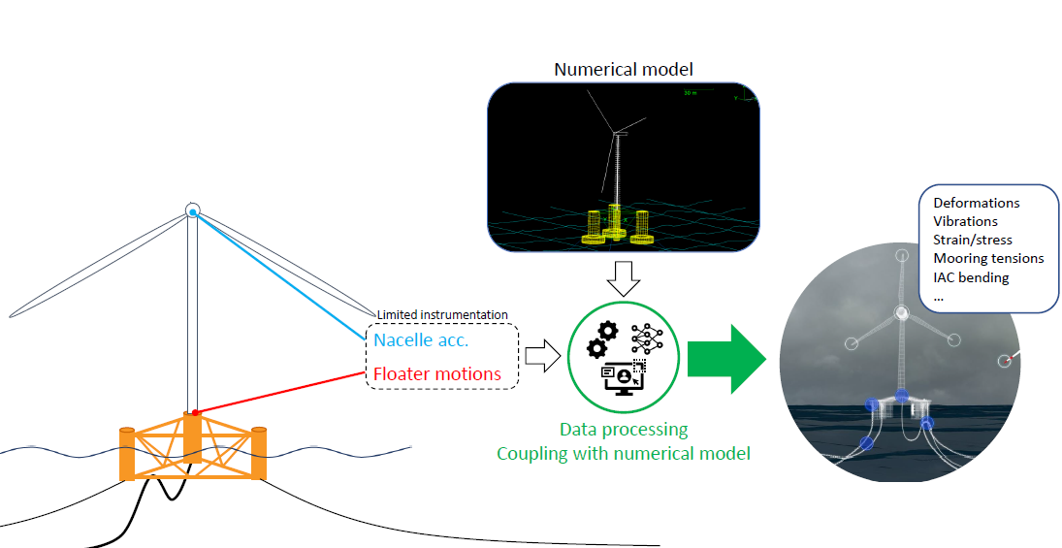
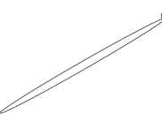
Digital Twin Overview – Goal
Digital Twin - Wind Turbine
What for ?
Improve availability
Reduce operational expenditure (OPEX)
Streamline inspection
Anticipate life extension
Improve future designs

Slide 27
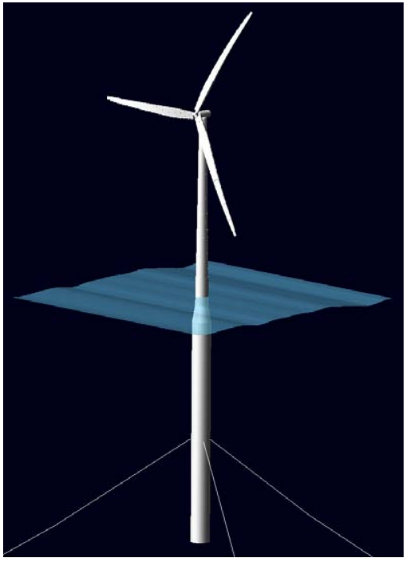







Digital Twin Overview – Benefits
 | Full sensor monitoring | Numerical monitoring | DT monitoring
Installation & maintenance costs
Accuracy
Reliability

Slide 28
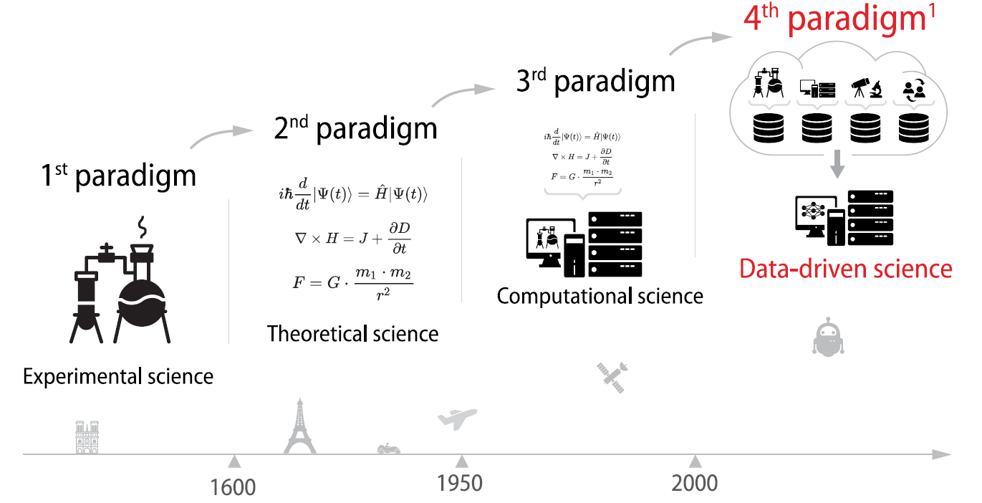
Digital Twin Overview – Scientific paradigm
1 Jim Gray,2007

Slide 29
Digital Twin Overview – Artificial Intelligence
Artificial
Intelligence (AI)
Machine
Learning (ML)
Deep
Learning (DL)
--------------------------
Based on artificial Neural networks

Slide 30
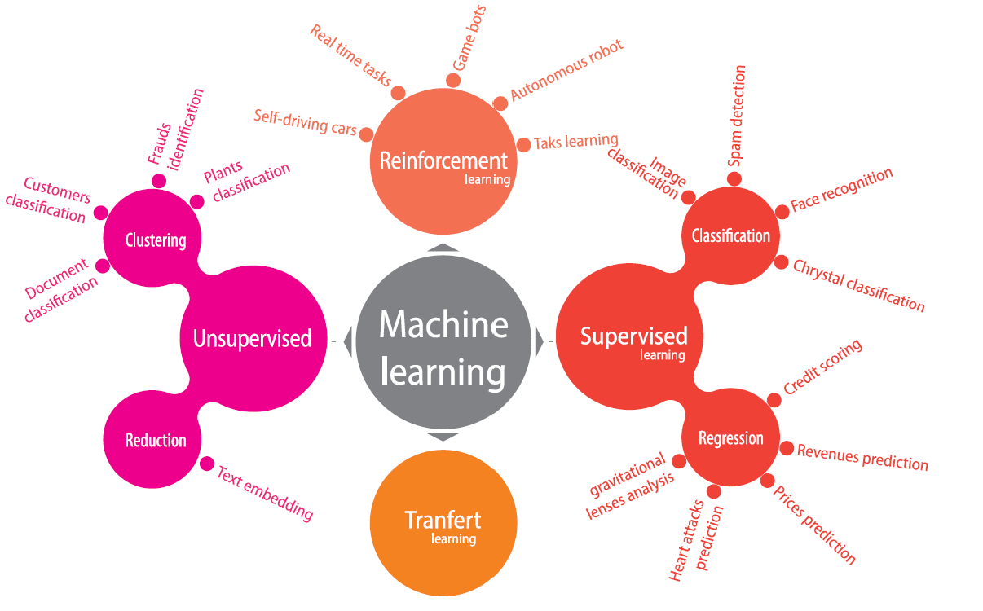
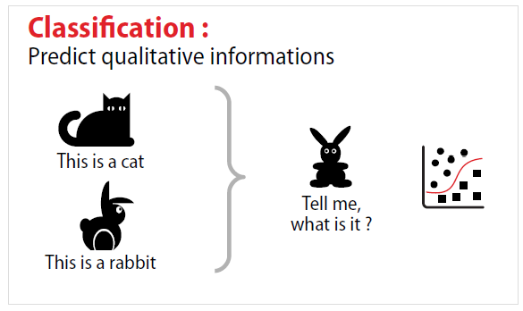
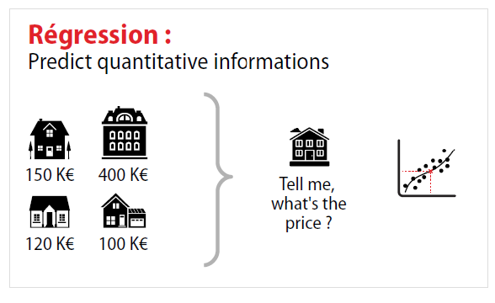
Digital Twin Overview – Machine Learning
Learning from
labeled data
Self-supervised:
Find the label inside the data!!
Could you give me an introduction to language models and explain how they work?
Language models, like GPT-4, are AI systems designed to understand and generate natural language text. They are trained on vast datasets of text from various sources, allowing them to predict the next word in a sentence or generate coherent responses to questions.
BERT, GPT-4,
Llama2,
BLOOM, etc…

Slide 31
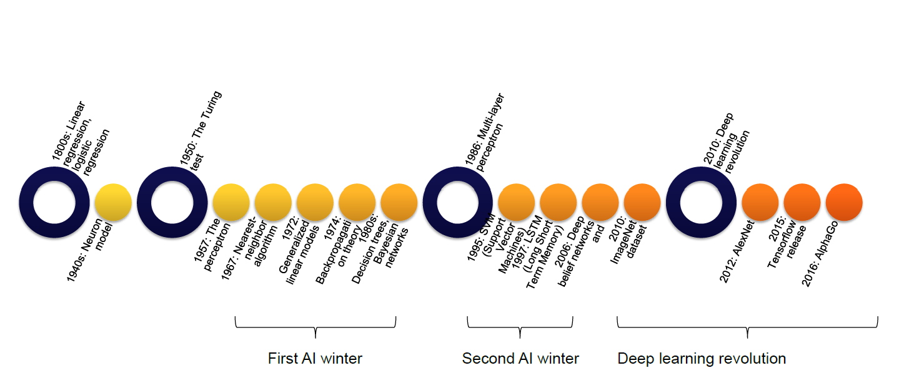
Digital Twin Overview – Machine Learning timeline

Slide 32
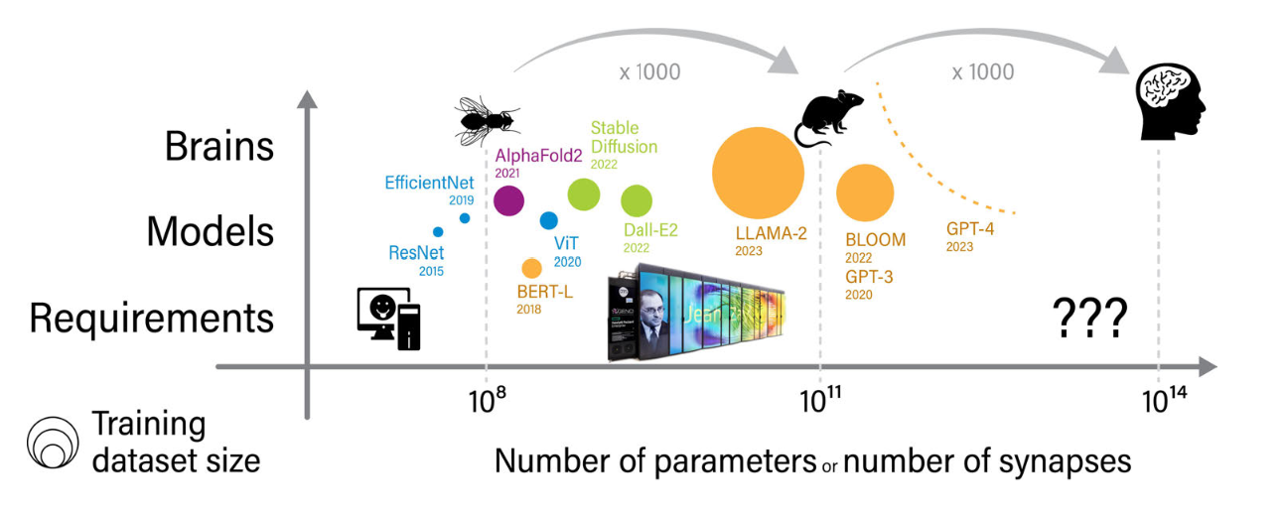
Digitial Twin – Artificial General Intelligence
Image Processing
Text-to-image
Protein Structure
Language
Models

Slide 33
Digital Twin Overview – A python centered world
Programming language
Computer = machine language (5 operations)
Programming language: a way to communicate with the computer
«01000010011011110110111001101010011011110111010101110010» => «Bonjour».
Interpreted or compiled
A compiled language requires a compilation step and is therefore less simple and less portable, but it is faster as it doesn't translate on the fly.
Python history
Language created in 1991 by Guido van Rossum, named in honor of Monty Python.
Python is a very powerful language that is continuously evolving thanks to libraries. It allows you to go from a simple script to complex software, including graphical interfaces and websites.
Who is using Python ?

Slide 34
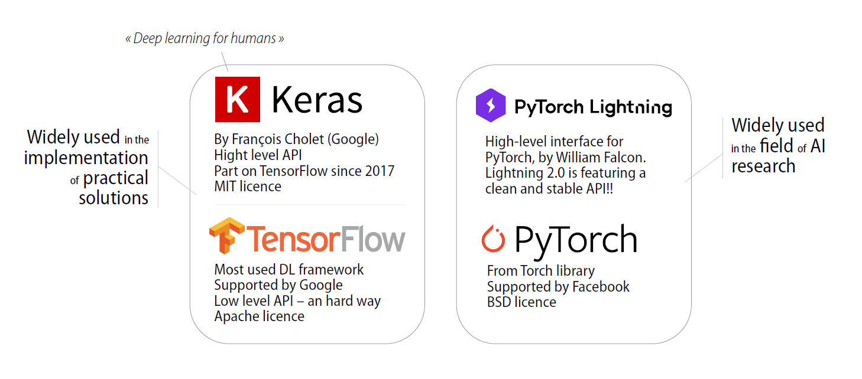
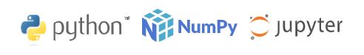
Digital Twin Overview – A python centered world

Slide 35

TP – Python introduction
What is Google Colab?
Google Colab which stands for Google Colaboratory is a cloud platform
provided by Google to run Python Notebook’s without need to install
anything on your local machine.
Features of Google Colab
Zero Setup Required
Free GPU Access
Pre-installed Libraries
Accessing Google Colab
https://github.com/Ahirvoas/Training-Day1/blob/main/Tutorial_day1-Python.ipynb
https://github.com/Ahirvoas/Training-Day1/blob/main/Tutorial_day1-Pandas.ipynb

Slide 36
TP – Python introduction
Exercice – [OPTIONAL]
Code a simplified roulette game where you can bet an amount of money, then win or lose money. When you have no money left, you lose.
Setup A roulette wheel consists of 50 slots numbered from 0 to 49. Even numbers are black, and odd numbers are red. The player starts with a bankroll of 1000.
Winnings
If the winning number is the one the player bet on, they win 3 times their bet.
Otherwise, the dealer checks the color of the winning number. If the player chose a number of the same color, they win 50% of their bet.
If not, they lose their bet.
Hint random.randrange(50) returns a random number between 0 and 49.

Slide 37
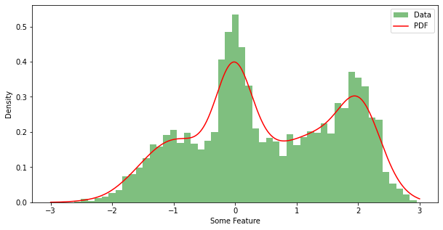
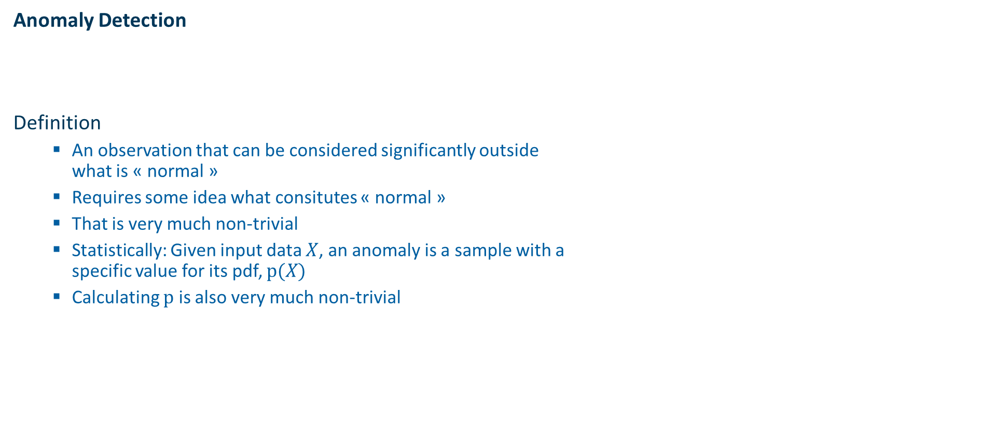
Digital Twin Overview – Classification
Anomaly Detection
Definition
An observation that can be considered significantly outside what is « normal »
Requires some idea what consitutes « normal »
That is very much non-trivial
Statistically: Given input data $X$, an anomaly is a sample with a specific value for its pdf, $p(X)$
Calculating $p$ is also very much non-trivial

Slide 38
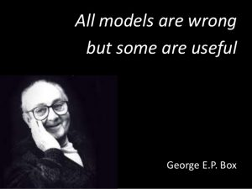
Digital Twin Overview – Anomaly Detection
Anomaly Detection
Idea
Expectation: in a healthy system there should be robust relationships between states of components
Example: the motion of a FOWT dominantly deponds on wind speed and other environmental conditions
Therefore, statistical modeling should deliver good predictions of first from the former
Deviations can be explained by defects between numerical model and measure
Environmental inputs
Wind speed & direction
Wave amplitude & direction
Current speed & direction
Atmospheric conditions
Output signals

Slide 39
TP – Python introduction
Accessing Google Colab
https://github.com/Ahirvoas/Training-Day1/blob/main/Tutorial_day1-Anomaly.ipynb

